Slide 1
AHCP – Small Rental Program Application Overview March 21, 2024
NEBRASKA DEPARTMENT OF ECONOMIC DEVELOPMENT
STATE OF NEBRASKA
Community Development Block Grant - Disaster Recovery (CDBG-DR) Program
DR-4420 / Winter Storm Ulmer, 2019

Slide 2
WebEx Overview
Utilize the chat during the conversation.
You will be muted at the beginning of the meeting. Please unmute yourself to ask questions and provide feedback during the discussion.
We are available via email at ded.cdbgdr@nebraska.gov for any additional thoughts or feedback.

Slide 3
AGENDA
Introductions
Program Overview
Application for Funding Process
Next Steps
Questions
Notes:
Speaker: DED
Talking Points:
Today we will provide a brief introduction of the IMP staff, provide updates on the status of the program, review the application for funding process, and provide an overview of next steps in the program
We will conclude with a Q&A

Slide 4
Introductions
Housing Programs Lead: Christina Zink
Housing Program Manager
Nebraska Department of
Economic Development (DED)
CDBG-DR Staff:
Jenny B. Mason
Disaster Recovery Director
Susan Nickerson
Disaster Recovery Coordinator
Jennifer Grove Attorney
Tia Loftin
Infrastructure Match Program Manager

Slide 5
AGENDA
Introductions
Program Overview
Application for Funding Process
Next Steps
Questions
Notes:
Speaker: DED
Talking Points:
We will now move into program updates.

Slide 6
Brief Point of Context
Of the total CDBG-DR award, federal rules require that:
80%
Most
Impacted and
Distressed
80% of total funds be invested in HUD-defined “Most Impacted and Distressed” counties of Dodge, Douglas, and Sarpy.
70% of total funds are to support low/moderate income (LMI) residents.
70%
Low/
Moderate
Income

Slide 7
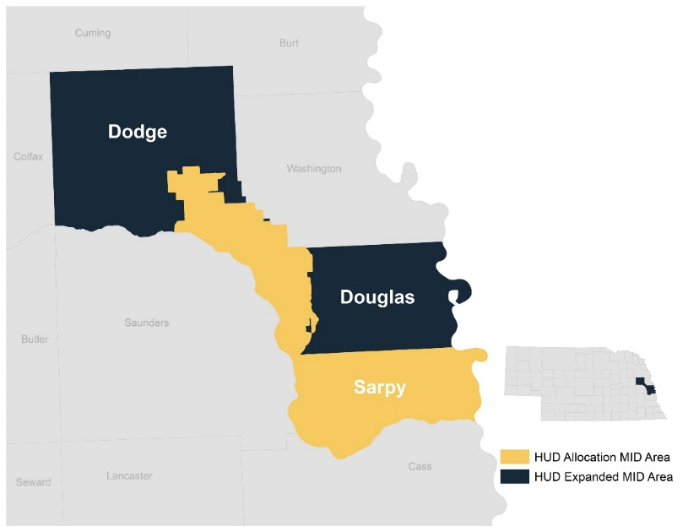
Brief Point of Context, Continued
Nebraska’s overall CDBG-DR strategy includes funding for:
Planning
Infrastructure
Housing
To provide flexibility for infrastructure and planning, the Affordable Housing Construction Program is targeted entirely to the HUD-identified MID Counties and LMI populations.
Small Rental Production is a “sub-program” within the broader Affordable Housing Construction Program

Slide 8
Affordable Housing Construction Program
Affordable Housing Construction Program
Homeownership Production Program | Small Rental Production Program | LIHTC Gap Financing Program
All programs provide financing to support production of affordable housing.
Available for affordable for-sale housing targeted primarily to LMI buyers. Financing includes funding for appraisal gaps and affordability gaps. | Available for affordable multifamily rental housing not otherwise seeking LIHTCs. Financing includes gap or primary financing. | Available for affordable multifamily rental housing combined with LIHTC from NIFA Financing includes gap financing.

Slide 9
Who is Eligible to Apply?
Developers of affordable rental housing, including:
Non-profit organizations, e.g., 501(c)(3) or 501(c)(4);
For- profit developers
PHAs; and
Units of local government
Counties;
Cities;
Villages;
Tribal Nations.
DED expects to enter into direct funding agreements with single-purpose, single-asset entities (e.g., limited liability companies) established to be the owner of the proposed project.

Slide 10
Small Rental: Eligible Activities
Financing is intended to focus on small multi-family projects.
Eligible applications should be multifamily rental projects with at least 12 units and no more than 32 units.
DED anticipates receiving proposals for:
New construction.
Acquisition/rehabilitation, including adaptive reuse and/or historic preservation.
Mixed-use projects may trigger additional requirements.
Projects may propose to serve:
Seniors (i.e., age-restricted at 55 or 62+) or
Families (i.e., without age restriction).
Priority for projects addressing
Displaced residents from the 2019 Winter Storm Ulmer and
Vulnerable populations (e.g., disabled, domestic violence victims, homeless)
Notes:
If you have a project outside the 12-32 units- please reach out to me/DED to discuss.
Mixed-use projects may require other additional requirements – please reach out to DED early on to discuss

Slide 11
Cross-Cutting Requirements
Fair Housing and Equal Opportunity | Labor Standards | Property Standards | Environmental Review | Relocation Requirements
Minority – and Women- Owned Business Enterprises | Section 3 | Green Building Standards | Duplication of Benefits | Procurement* If applicant is a subrecipient

Slide 12
Small Rental Production Program Structure

Slide 13
AGENDA
Introductions
Program Overview
Application Process
Next Steps
Questions
Notes:
Speaker: DED
Talking Points:
We will now move on to the Application for Funding process

Slide 14
Application Timeline
Small Rental Program Timeline
Date | Event/ Action | Location | Responsible Party/ies
Thursday, March 21, 2024 | Application Information Session at 9:00AM CST/8:00AM MST | WebEx | NDED
Friday, March 22, 2024 | Application Portal opens at 8:00AM CST/7:00AM MST | CDBG-DR webpage https://opportunity.nebraska.gov/programs/community/cdbg-dr/ | NDED
Friday, April 5, 2024 | Required Letter of Intent must be received by 5PM CST/4PM MST | Email completed LOI to: christina.zink@nebraska.gov | Applicant
Thursday, May 2, 2024 | Office Hour at 9:00AM CST/8:00AM MSTs | Available via email notification | NDED
Friday, May 24, 2024 | Application Closes at 5PM CST/4PM MST | Completed in AmpliFund https://opportunity.nebraska.gov/cdbg-dr | Applicant
Friday, July 26, 2024 | Notification of Intent to Award* | Issued via email | NDED
*In the event the Small Rental funds are not all awarded in the 2024 application cycle, DED will initiate a second application cycle. Similarly, in the event DED increases the funds allocated to AHCP, DED may re-consider acceptable applicants not previously selected for funding without re-opening the Program.

Slide 15
Threshold Requirements
Threshold Requirements
Letter of Intent submitted by the due date | □ Yes/ □ No
Project incorporates CDBG-DR mitigation and green building standards | □ Yes/ □ No
The project is NOT located in the floodway | □ Yes/ □ No
The project is NOT located in the 100-year floodplain | □ Yes/ □ No
Applicant has development experience, including staff and board expertise adhering to state and federal funding requirements | □ Yes/ □ No

Slide 16
Letter of Intent
All Small Rental applicants are required to submit a Letter of Intent to allow DED to verify eligibility, provide technical assistance, allow sufficient time for application review, and plan for scoring.
Only full applications, submitted by eligible applicants that have submitted a Letter of Intent will be accepted.
The Letter of Intent template can be found in the Templates and Exhibits section of the Small Rental Application Guidelines or on the DED CDBG-DR website at: https://opportunity.nebraska.gov/hud-requirements/cdbg-dr-program-guidelines/
LOI must be received by no later than 5:00 pm, Friday, April 05, 2024.
Failure to submit a Letter of Intent will result in an application not being reviewed, scored, or eligible for award.

Slide 17
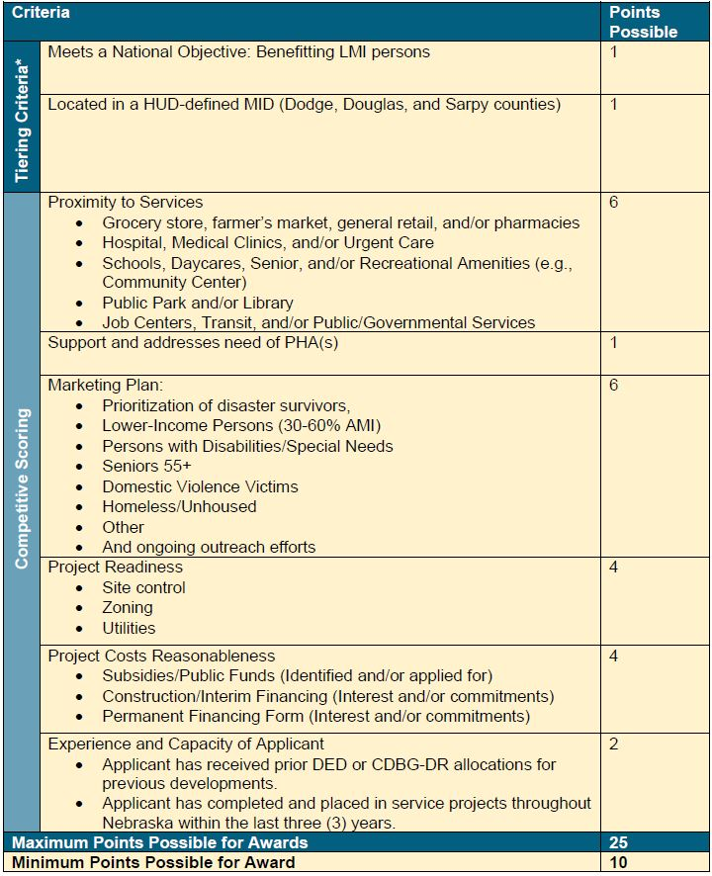
Competitive Selection Criteria

Slide 18
Application for Funding Overview
The maximum award limit is $2,000,000. Consistent with the Action Plan, awards are subject to the following additional restrictions:
Not to exceed $150,000 per affordable housing unit
The $150,000 per unit includes all hard and soft costs
The Application for Funding is made up of the following sections:
General Information
Project Information*
Project Readiness, Cost Reasonableness, Experience and Capacity*
Proforma, Application Authorization, Exhibits and Uploads
Budget
*Sections contain competitive scoring criteria
Notes:
Speaker: DED
Talking Points:
Shown here are the sections of the Application for Funding Template.
Please note that while DED is drafting, the application however needs to read as though this is coming from the applicant hence their review, verification and signature.
DEDs focus is on the HUD/federal portions of the application (e.g., National Objective), and applicants are expected to provide additional details.
On the next few slides, we will highlight key portions of the application and discuss the applicant’s role.

Slide 19
Part I: General Information
Notes:
Enter all contact and organizational information
Ownership information, if you have it at this time
Development Team – there will be drop down questions
Opportunity to upload an organizational chart, if applicable
Developer, General Partner, Contractor, etc.
Ask to disclose any Identity of Interest

Slide 20
Part II: Project Information
Notes:
Development, Construction and Site info; Proximity to Services; Support PHA; Marketing plans
Development Information: Threshold Questions (MID, LMI, Floodplain, Green Building); Total Project Costs
Construction Information:
One-page Summary (upload)
Acquisition/Rehab- capital needs assessment
Relocation- URA plan
Site Info:
Type of Development (MF, Duplex); Number of building, sq ft, etc.
Preliminary Archit plan, if available
Proximity to Services + Support PHA +Marketing Plans- are tied to scoring
Proximity to Services – project is located within 3 miles of service categories listed
Upload a map will have an example to share.
1 point for each category that falls within the 3 miles; extra point if all 5 categories are represented
Support PHA – 1 point if yes
Upload a letter of intent or commitment from a PHA
This could be an official letter or email – acknowledging you want to work together
Marketing Plan – 1 point each
Select all that apply; use other if needed
Upload a market study or housing needs

Slide 21
Part II: Project Information Continued
Notes:
Development info; Construction Info; Site info; Proximity to Services; Support PHA; Marketing plans) Proximity to Services + Support PHA +Marketing Plans- are tied to scoring Proximity to services- will have an example to share.

Slide 22
Part III: Project Readiness, Cost Reasonableness, Experience and Capacity
Notes:
Project Readiness, Cost Reasonableness, Experience & Capacity – scoring categories
Project Readiness: Site control; Zoning; Utilities
1 point for each category; additional point if you have all 3
Show proof via uploads for point
Cost Reasonableness: Subsidies; Construction Financing; Permanent Financing
1 point each; additional point all 3
Can upload either an official letter or email – interest or commitment
Want to see what other sources of funding you are considering or have planned
Experience and Capacity:
1 point each
Experience with DED funding; and NO outstanding findings
Greater Neb. Housing experience- name of project, Location, PIS date

Slide 23
Part IV: Proforma, Application Authorization, Exhibits and Uploads
Notes:
Upload Proforma from DED website.
Option to provide additional narrative.
Upload additional DED exhibits - found on DR website.

Slide 24
Part IV: Continued - Proforma
Notes:
Upload Proforma from DED website. Option to provide additional narrative. Upload additional DED exhibits - found on DR website. Authorization.

Slide 25
Part IV. Continued - Proforma Overview
The Small Rental Production Proforma is designed to capture information on the project’s Units & Revenue; Operating Budget; Development Budget; 20-Year Projection and Lease-Up.
Start with the Units & Revenue tab - information entered will carry through to the other sheets.
Input data into the yellow shaded cells. The unshaded cells calculate automatically.

Slide 26
Part IV: Continued- Exhibits and Uploads
https://opportunity.nebraska.gov/hud-requirements/cdbg-dr-program-guidelines/
https://opportunity.nebraska.gov/programs/community/cdbg-dr/
HUD Requirements
Program Guidelines
Affordable Housing Construction Program
Notes:
Upload Proforma from DED website. Option to provide additional narrative. Upload additional DED exhibits - found on DR website. Authorization.

Slide 27
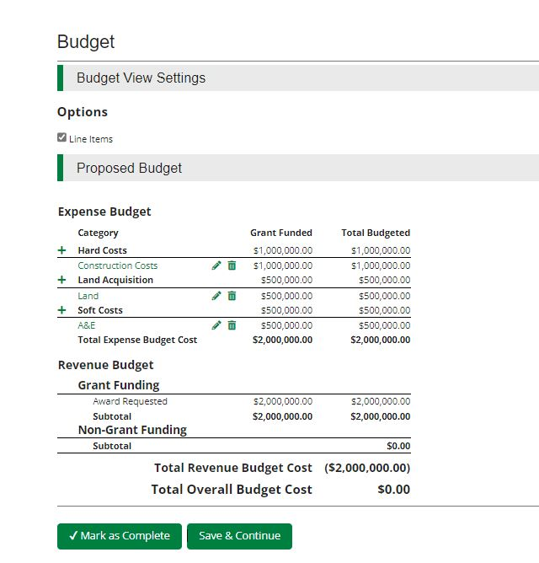
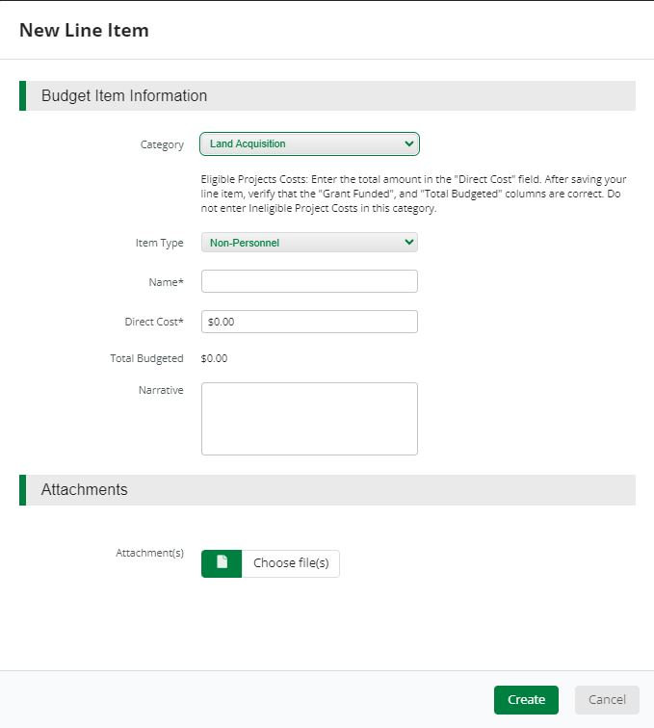
Budget
Notes:
Budget - Hard costs, land, soft costs: all must equal amount requested.

Slide 28
Questions?

Slide 29
Small Rental Timeline
Small Rental Program Timeline
Date | Event/ Action | Location | Responsible Party/ies
Thursday, March 21, 2024 | Application Information Session at 9:00AM CST/8:00AM MST | WebEx | NDED
Friday, March 22, 2024 | Application Portal opens at 8:00AM CST/7:00AM MST | CDBG-DR webpage https://opportunity.nebraska.gov/programs/community/cdbg-dr/ | NDED
Friday, April 5, 2024 | Required Letter of Intent must be received by 5PM CST/4PM MST | Email completed LOI to: christina.zink@nebraska.gov | Applicant
Thursday, May 2, 2024 | Office Hour at 9:00AM CST/8:00AM MSTs | Available via email notification | NDED
Friday, May 24, 2024 | Application Closes at 5PM CST/4PM MST | Completed in AmpliFund https://opportunity.nebraska.gov/cdbg-dr | Applicant
Friday, July 26, 2024 | Notification of Intent to Award* | Issued via email | NDED
*In the event the Small Rental funds are not all awarded in the 2024 application cycle, DED will initiate a second application cycle. Similarly, in the event DED increases the funds allocated to AHCP, DED may re-consider acceptable applicants not previously selected for funding without re-opening the Program.

Slide 30
Submission Summary
Submission Summary
Letter of Intent | Full Application
Submit via email to: Christina Zink, Housing Program Manager, Disaster Recovery, at christina.zink@nebraska.gov Due: Friday, April 05, 2024 at 5PM CST/ 4PM MST | The full application must be completed in AmpliFund. Full application can be found here: https://opportunity.nebraska.gov/cdbg-dr Due: Friday, May 24, 2024 at 5 PM CST/ 4PM MST

Slide 31
Next Steps
Visit the DED CDBG-DR Program Website | Provide Feedback Directly to DED | Attend Future Application Office Hour
Review Application Guidelines, Program Guide, and update/verify AmpliFund Log-In. | Submit LOI to christina.zink@nebraska.gov by 5:00 pm CST April 05, 2024 | Attend open Office Hour on Thursday, May 02, 2024. Available via email notification.
Website: opportunity. nebraska.gov/cdbg-dr
Email: ded.cdbgdr@nebraska.gov

Slide 32
Additional Program Resources
All CDBG-DR related information can be found on the DED website at: https://opportunity.nebraska.gov/programs/community/cdbg-dr/
HUD Requirements> Program Guidelines & Resource Library
Small Rental Program Guide
Nebraska CDBG-DR Toolkit
CDBG-DR Manual
CDBG-DR Technical Assistance
Affordable Housing Construction Program Fact Sheet and FAQ
CDBG-DR Green Building Standards

Slide 33
Contact Information
Christina Zink
Housing Program Manager
ded.cdbgdr@nebraska.gov

