Slide 1
NEBRASKA DEPARTMENT OF ECONOMIC DEVELOPMENT
Small Business Support
Grant -
Recipient Information
Session #3

Slide 2
Agenda
Introductions
Contracts
Payment Schedule Information
Grant Budgets
Custom Forms - AmpliFund
Recipient and Project Information Form
Site Review Form
Release of Funds Letter
Site Review
Payment Requests
Frequent Questions
SBSG Checklist
Resources Available to Recipients
Resources Available to Awardees

Slide 3
Introduction
Team Members:
SBSG Program Manager: Deisy Coyle
Economic Development Consultants: Diamond Cook & Atticus Stansbury
Business Managers: Elizabeth Blanco & Daren Waters
Lead Program Manager: Ryan ZimmerMas
In-Person Locations
North Omaha Office: 5319 N 30th St., Suite B, Omaha NE 68111
Office Hours:
Tuesdays from 10:00 a.m. to 1:00 p.m.
Thursdays from 12:00 p.m. to 3:00 p.m.
South Omaha Office: 2909 Edward Babe Gomez Ave., Omaha, NE 68107
Office Hours:
Mondays from 10:00 a.m. to 1:00 p.m.
Wednesdays from 12:00 p.m. to 3:00 p.m.

Slide 4
Contracts
Before executing the contract:
(1) Review clerical or typographical errors
(2) Verify the Scope of Service (Article II); and
(3) Contact information.
Do not execute the document if modifications are required.
Notes:
Refer them to recordings.

Slide 5
Payment Schedule & Grant Budget
Ryan ZimmerMas

Slide 6
DISCLAIMER
Every Payment Schedule is unique and customized to each Recipient.
While a template version is shown in the next few slides, please consult your payment schedule email for details.
DED recommends thoroughly reviewing your payment schedule before approving it.

Slide 7
Payment Schedule Information
Upon full execution of the Award Agreement (contract) and the meeting of any required conditions specified in the Award Agreement, the Recipient will receive an email with the payment schedule information.
LB531 § 81-12,244. 51. (4) For grants awarded under this section, the division shall pay a grantee an advance of fifty percent of the total grant awarded with the remaining grant funds paid on a monthly basis until the grant is paid in full or by December 31, 2027, whichever occurs sooner.
This is unique to the NSORG program

Slide 9
Help! My Payment Schedule Doesn't Align with my Project Schedule!
Recipients have three options if the project expends funds faster than the payment schedule provides payments:
Reimbursement upon project completion: Recipients may submit a final reimbursement payment once the project is complete.
Example: Project scope deliverables are met, and full grant amount is expended by August 2025. Recipient requests the remaining balance of the grant as reimbursement upon completion.
Preferred Option

Slide 10
Option 2: Shorten Period of Performance
Shorten Period of Performance: Recipients may elect a shorter period of performance if the project scope deliverables will be met early.
Advances with Reimbursement Payments: Recipients can switch to a 50% advance with monthly reimbursement payments once the initial advance is fully expended.
This requires the recipient to have working capital and then receive reimbursements.

Slide 11
Grant Budgets & Administrative Expenses
DED is reviewing all grant budgets to ensure alignment with the project scope (Article 2: Scope of Service) and compliance with a 10% cap on administrative expenses.
What counts toward the 10% limit on administrative expenses?
Costs associated with managing the grant (direct administration)
Organizational overhead costs (indirect)
This is relatively rare.
If your grant budget includes organizational overhead, DED will review and contact you if additional information is needed.
Generally, DED recommends against including indirect unless necessary.
Costs associated with carrying out activities listed in the scope are generally not considered “administration.”

Slide 12
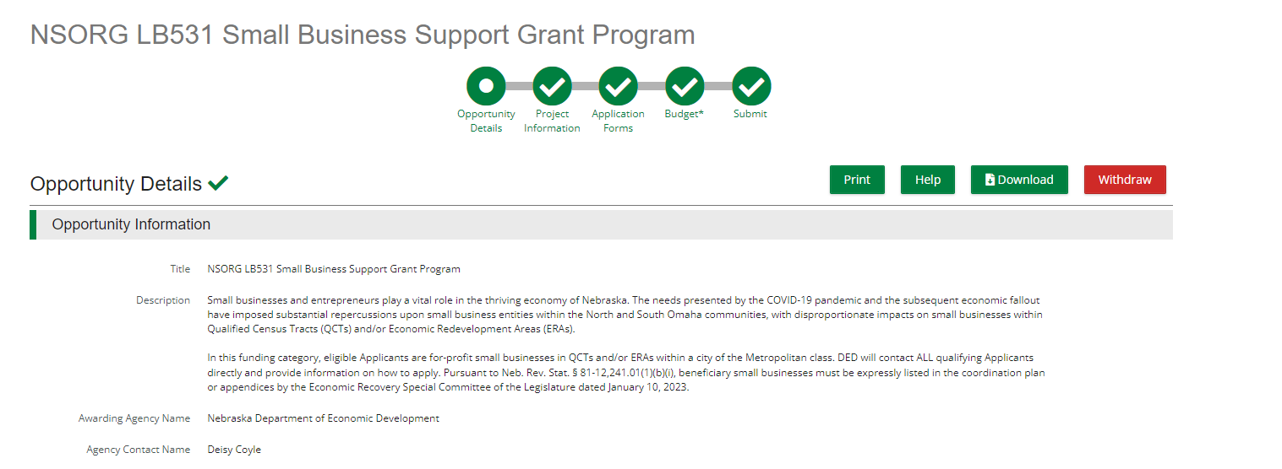
Award Activation
THIS IS AN INTERNAL PROCESS DONE BY DED ONLY
Opportunity
Award

Slide 13
Award Activation
Once your award is activated be sure to:
Have two authorized users in your recipient portal on AmpliFund and Assign the role of "Grant Manager"
Complete Recipient and Project Information Form
Site Review Form
Complete the "W9 & ACH" form in AmpliFund with your separate bank account information.
Grant funding must be deposited into a new, separate bank account that will be used solely for grant expenses & deposits.

Slide 14
Custom Forms
There are three custom forms that must be completed via AmpliFund before the site visit:
W9 & ACH: This form collect the bank account information from the recipient.
Recipient and Project Information: This form collects basic contact information for the recipient and project.
Site Review Form: The Site Review Form collects specific information regarding the project location.
Notes:
W9 & ACH: This form collect the bank account information from the recipient.
Recipient and Project Information: This form collects basic contact information for the recipient and project.
Site Review Form: Collects important information, including attachments of Proof of Ownership, Lease, MOU, or Purchase Agreement for the location of the project.

Slide 15
Why I don’t see the custom Forms
Three things need to happen in order to see and complete the custom forms
Executed contract
Payment Schedule information approved by recipient
Award Activated (DED Internal Process)

Slide 16
How to access the custom Forms
Custom
Select the Form
Start New Form

Slide 17
Final Steps
Site Visit: DED conducts site visits to ensure the accuracy of information provided, assess the suitability of the location for the intended purpose, verify compliance with regulations.
Release of Funds Letter: Confirmation that grant funding is ready to be released.
Payment Request: 50% of the grant.

Slide 18
Payment Request Webinar
For more information on the process of submitting a payment request, there is a separate webinar being held for all the NSORG grant recipients focusing on Payment Requests.
NSORG Lunch & Learn Session #3
Topic: Reporting Expenses & Requesting Funds
Date & Time: April 10th, 2024
Location: Hybrid, Microsoft Teams & 1313 Farnam Street, Omaha, NE., 68102
Registration Link:
https://events.gcc.teams.microsoft.com/event/507d5061-7a66-49e1-b0f9-ac7187a559a3@043207df-e689-4bf6-9020-01038f11f0b1
Notes:
Spoiler allert

Slide 19
Frequent Questions
Why do I need to create a separate bank account for grant related expenses?
Creating a separate bank account for grant-related expenses offers several benefits, including:
Financial Transparency
Accountability
Budget Management
Risk Mitigation
Notes:
Financial Transparency: It separates other funds and grant funds avoiding mixing issues.
Accountability: This makes it easier to track expenditures, demonstrate proper use of grant funds, and comply with reporting requirements.
Budget Management: A separate bank account simplifies budget management by allowing grant funds to be isolated from other sources
Risk Mitigation: It reduces the risk of financial mismanagement by limiting access to grant funds to authorized individuals or departments.

Slide 20
Frequent Questions
Does my grant have to last until December of 2027, or can it end sooner?
The duration of your grant can vary depending on the terms outlined in the grant agreement.
If you have questions or concerns about the duration of your grant, it's advisable to consult the Program Manager for clarification and guidance.
Why does DED have to conduct a site visit?
DED conducts site visits to ensure the accuracy of information provided, assess the suitability of the location for the intended purpose, verify compliance with regulations, and address any potential issues or concerns firsthand.
DED will conduct site visit within two days of the site review form submission
Notes:
Why does DED have to conduct a site visit?
DED conducts site visits to ensure the accuracy of information provided, this is with the soul purpose of verify accuracy from the legislation.

Slide 21
Frequent Questions
What if I review my contract & decide that the scope of service, I am obligated to achieve is unattainable?
In the event that upon reviewing your contract, you realize that you may encounter challenges in fulfilling the described scope of work, it is imperative to promptly contact the program manager to discuss potential adjustments or revisions to your scope of work.
What happens if I fail to achieve the scope of work that I accepted on my contract?
DED must draft the Scope of Service, basing on what was submitted in the application.
You should scale down your scope if you received a partially funded award.
Communicate with Program Manager.
Notes:
DED must draft the Scope of Service, basing on what was submitted in the application, and we are happy to negotiate on the scope if you don't think it is achievable.
You should scale down your scope if you received a partially funded award to ensure it is achievable with the reduced grant amount.
If part of the way through the project you realize the scope will be unachievable, it is possible to request amendments. Things change and transparency & communication are key.

Slide 22
Additional Questions

Slide 23
Small Business Support Grant Recipient Checklist Session #3
Session #3 Check List
Find the Session #3 Check List here
Complete SBSG Checklist:
Find the Complete SBSG Check List here

Slide 24
Resources Available to Recipients
AmpliFund Point of Contact (+1-844-745-0239)
AmpliFund Online Chat Feature Link: How to Request Technical Assistance – DED Grants Help Center (zendesk.com)
Business Managers
North Omaha: Daren Waters (daren.waters@nebraska.gov)
South Omaha: Elizabeth Blanco (elizabeth.blanco@nebraska.gov)
Economic Development Consultants
Atticus Stansbury (Atticus.Stansbury@Nebraska.gov)
Diamond Cook (Diamond.Cook@Nebraska.gov)

Slide 25
Resources for Awardees
Program Manager
Zendesk
AmpliFund support
Lunch & Learns
Office Hours
Notes:
Tour of NSORG website with references to each of these resources

Slide 26
Additional Informational Webinars
Beginning Wednesday, March 20th, DED will hold weekly Lunch & Learn workshops over the lunch hour on a variety of grant – related topics. The full list of webinars can be found at the DED website, NSORG webpage.
Session #1 pt. 2: Getting Started with your NSORG Award
March 27th, 12:00 – 1:00 p.m.
Session #2: How to get the most out of a partially funded award
April 3rd, 12:00 – 1:00 p.m.
Session #3: Reporting Expenses & Requesting Refunds
April 10th, 12:00 – 1:00 p.m.
Session #4: Preformance Reporting
April 17th, 12:00 – 1:00 p.m.
Session #5 Personnel Expenses & Documentation
April 24th, 12:00 – 1:00 p.m.

Slide 27
Resources Available to Recipients
Program Manager:
Deisy Coyle - deisy.coyle@nebraska.gov - 531-500-9577
Nebraska Department of Economic Development Website
Link: https://opportunity.nebraska.gov/programs/recovery/nsorg/
Program Manual
Link: Program-Manual_Omaha-Recovery-Grants_1.2_final.pdf
DED Grant Help Center
Link: DED Grants Help Center (zendesk.com)

